Slide 1
Artificial Intelligence Workshop Day 1
Yathish N V

Slide 2

KNOW ABOUT ME Yathish N V
Computer Science Engineering at PESU.
ML and Computer Vision Research Intern at Viga Entertainments.
Student Intern at Bolt IoT.
Specialization in Machine learning and Data Science.
Mentor at Mahil-AI workshop.
Android Developer.
Project- Deep Fake Detection
LinkedIn
yathishnv27@gmail
9538198724

Slide 3
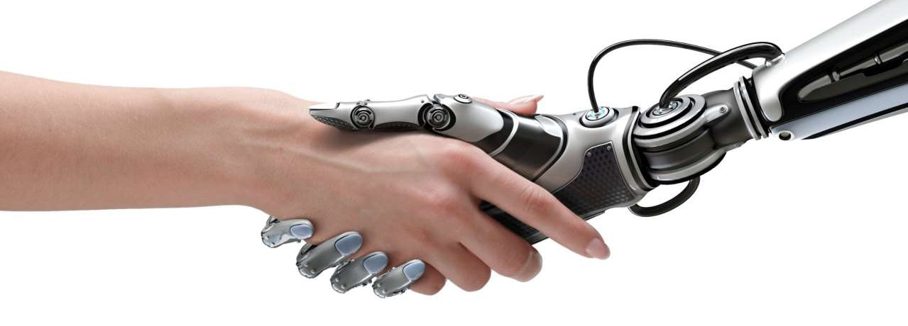
What is Artificial Intelligence?

Slide 4
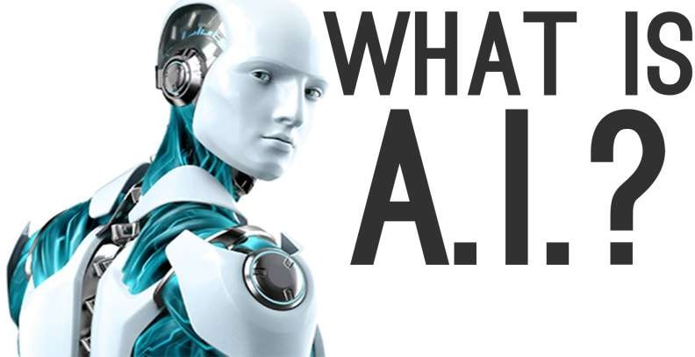
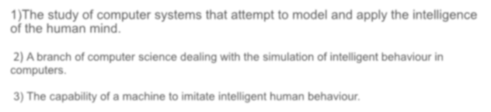


The study of computer systems that attempt to model and apply the intelligence of the human mind.
A branch of computer science dealing with the simulation of intelligent behaviour in
computers.
The capability of a machine to imitate intelligent human behaviour.

Slide 5

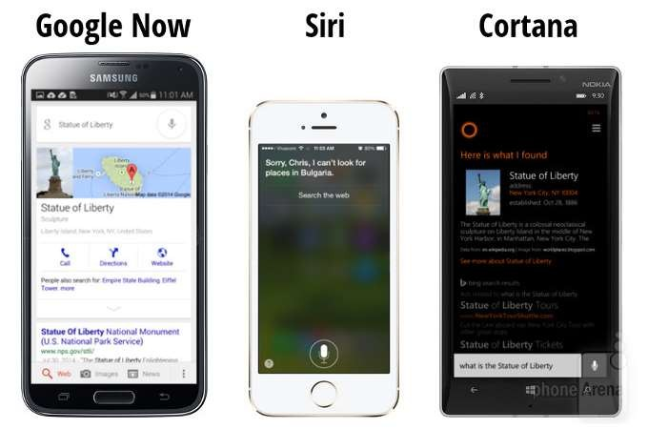
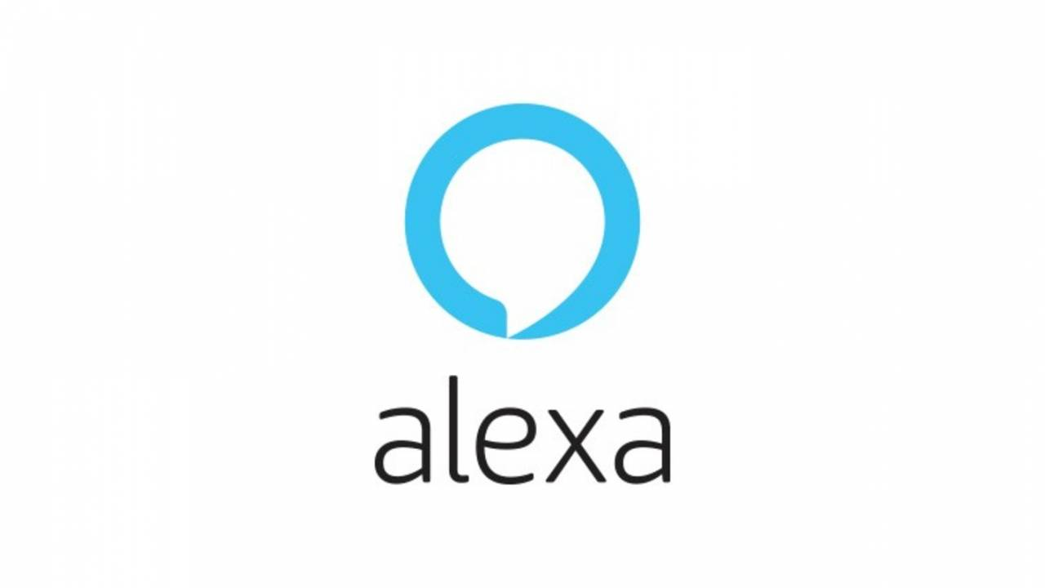

Slide 6

Let’s do some drawing with Google QuickDraw!
g.co/quickdraw
Notes:
So, how was the experience?
Wasn’t it amusing!?
Any idea how all this works?

Slide 7
Overview
Today’s Topics
What is AI?
History
Introduction to Google Colab
Anaconda Software Installation
Final Project
Simple Linear Regression from scratch in Python and plot your regression line using matplotlib and predict next outputs.
Implement a simple ANN using TensorFlow

Slide 8

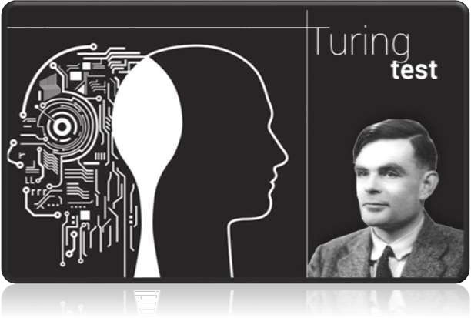
Early History
In 1950 English mathematician Alan Turing wrote a landmark paper titled “Computing
Machinery and Intelligence” that asked the question: “Can
machines think?”
Further work came out of a 1956 workshop at Dartmouth sponsored by John McCarthy. In the proposal for that workshop, he coined the phrase a “study of Artificial Intelligence”

Slide 9
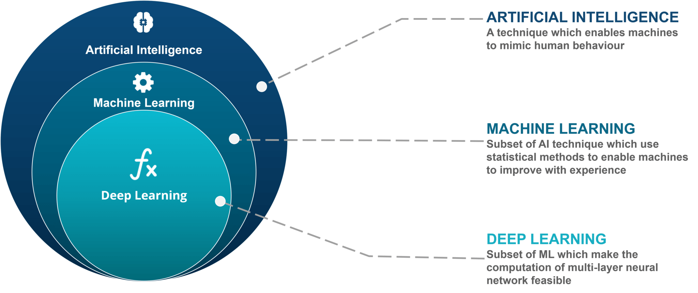
AI vs ML vs DL

Slide 10
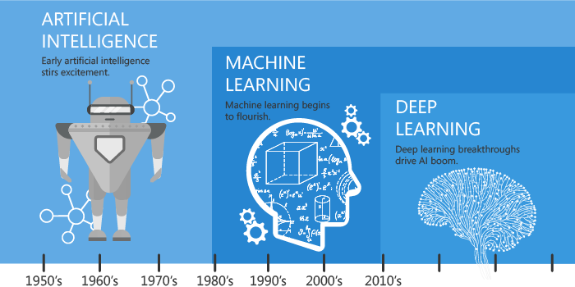
Trends in AI

Slide 11
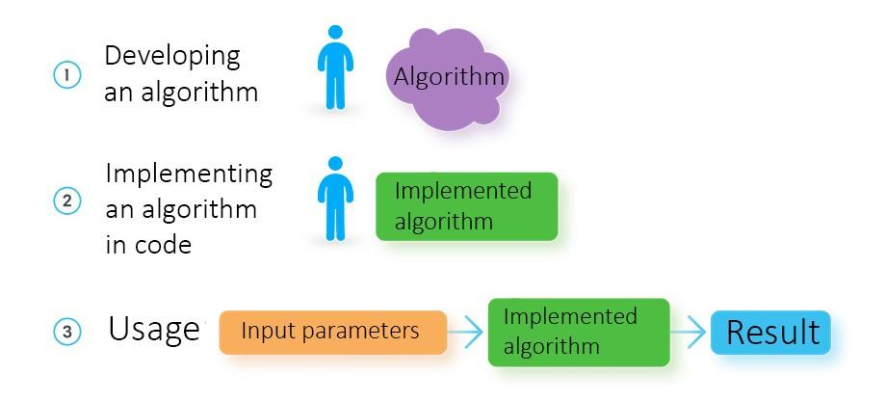
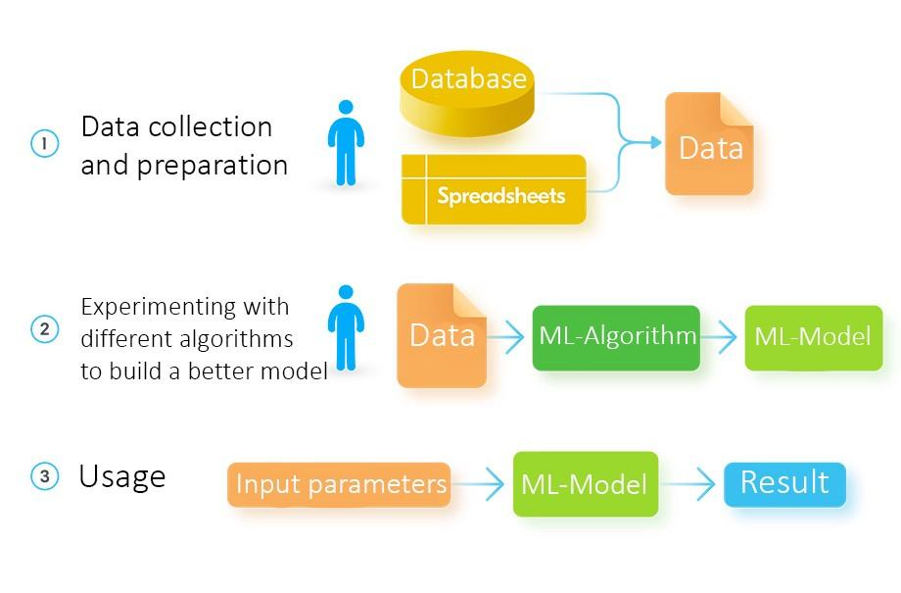
Traditional Programming vs Machine Learning
Traditional Programming
Machine Learning
Source: https://towardsdatascience.com/machine-learning-vs-traditional-programming-c066e39b5b17
Notes:
Let’s see how Machine Learning is different from Traditional Programming

Slide 12
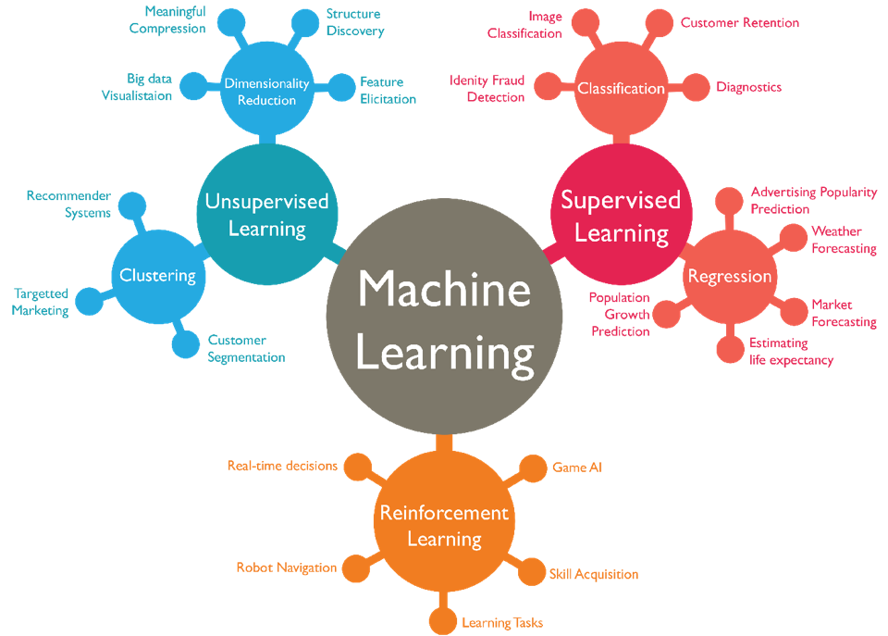
Types of Machine Learning
Supervised Learning
Regression
Decision Trees
Random Forests
Classification
KNN
Trees
SVM
Bayesian
Unsupervised Learning
Clustering
Reinforcement Learning
Q Learning

Slide 13
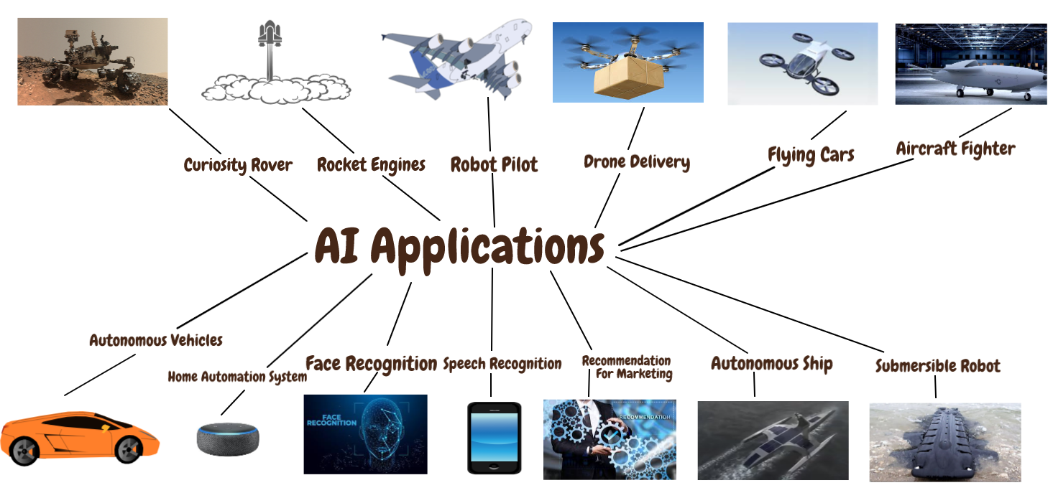
Applications of AI
Self driving cars
Cancer diagnosis
Voice assistants
Machine translation
Image recognition
Share market prediction
Predicting natural calamities
Text generation
Image captioning
Facial recognition

Slide 14
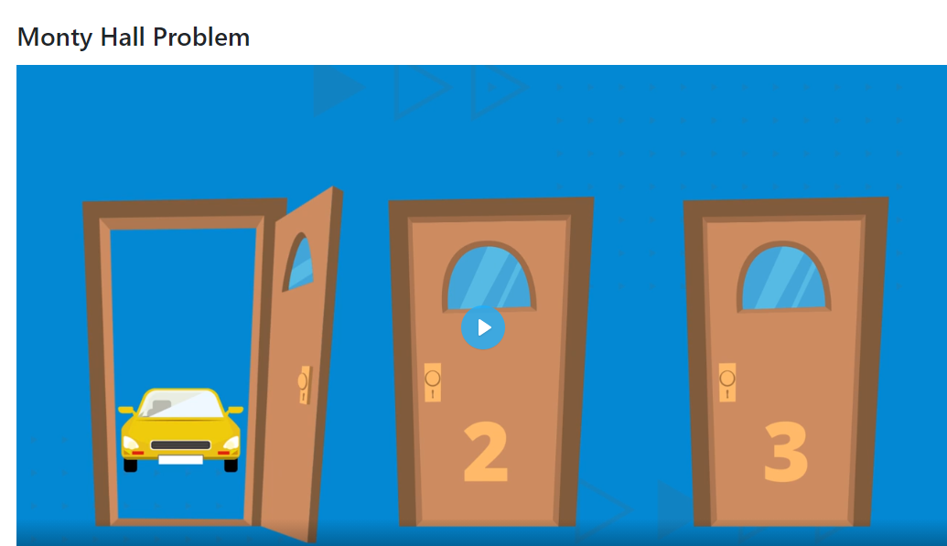

Slide 15
Resources
Deep Learning Definition - Neural Networks
Artificial intelligence vs Machine Learning vs Deep Learning
Difference between Deep Learning & Machine Learning
AI, Machine Learning, Deep Learning Explained Simply | by Jun Wu
What is Deep Learning?, machinelearningmastery.com
78 Responses to 8 Inspirational Applications of Deep Learning
Deep Visual-Semantic Alignments for Generating Image Descriptions
Global Big Data Conference

Slide 16
Thank You

